Slide 1
👋 Hello & Welcome
⏳ This session will begin shortly.
While you wait, please download the slides for today’s session from the LevUL up website.
In association with:

Slide 2
Recording
This session will now be recorded. Any further information that you provide during a session is optional and in doing so you give us consent to process this information.
These recordings will be stored by the University of Limerick for one year and may be published on our website during that time.
By taking part in a session you give us your consent to process any information you provide during it.

Slide 3
Being Engaged and Establishing Your Social Presence Online
Dr Michael Wride,
Transformative Pedagogies Lead

Slide 4
Overview
In online learning environments, you should think proactively about how you meet and engage with fellow students and how you communicate with your lecturers.
You’ll need to actively participate in your learning.
In this workshop, we will discuss some ideas on how to do this focusing on the concept of 'social presence' in the online environment.

Slide 5
Being present
You can participate in class online just as you would in a face-to-face class.
The technology used in virtual classrooms allows you to raise your hand to ask a question and take part in group discussions.
Learning online doesn’t mean learning in isolation.
You will be part of many student groups such as a class group, module group and a course group.

Slide 6
Your fellow students are one of your greatest resources.
If you are able, attend the scheduled on-campus sessions. Even if these are optional it is still a good idea to go - it will help you to feel connected to your classmates.
Take part in discussion forums - even if you are only acknowledging the comments of others. It is a great way to get to know each other. Start by introducing yourself, where you are from. Don’t forget to take note of any tips or useful advice.
Join (or create!) an online study group

Slide 7
What is Social Presence?
Who are we when we go online?
How do others know we are there?
How do others perceive us?
How do we become ‘comfortably embedded’ within a community?

Slide 8
What is Social Presence Online?
“The degree of awareness of others in an interaction.”
“Perceptions of each other’s immediacy, intimacy, and a sense of group cohesion.”
“Comfort and emotional connections among learners in online learning environments.”
“Perceptions of social presence are influenced by the design and characteristics of online learning contexts; i.e., social affordances.”
“Some online learning spaces afford more social interactions, and therefore, are more sociable….sociability can be defined as the degree an online learning environment can support the creation of an effective social space where learners trust each other and feel connected with the group.”
Akcaoglu & Lee (2016) Increasing Social Presence in Online Learning through Small Group Discussions. Int.Rev. of Res. in Open and Distributed Learning. 17(3): 1-17.
Notes:
All lecturers value their teaching time and time with you the students immensely. We realize that this move to hybrid teaching and learning is challenging for both students and for staff. We want you to know that you are not alone in feeling frustrated with this situation.
Feeling connected to the Trinity community and being aware that ‘we’re all in this together’ can go a long way to help decrease the frustrations of having to learn in these challenging circumstances. You might also find it beneficial to share your own frustrations as well as positive experiences about learning online with your fellow students. You can do this with your classmates by participating in class learning and with other students by joining a club or society.

Slide 9
Some Background & History
The theory of social presence dates back to the work of Short, Williams and Christie in the 1970s.
Interested in how media influences how people communicate.
Later, educators also became interested in the ways that instructors and students make up for the loss of visual cues in online learning environments, while still being able to share who they are as ‘real people’ through their behaviors (‘immediacy behaviours’).
Social presence is a ‘contested concept’ as can also be defined “in terms of connection, belonging, and community” and “social presence, collaboration, and community are three important, but different constructs” Lowenthal & Dennen (2017).

Slide 10
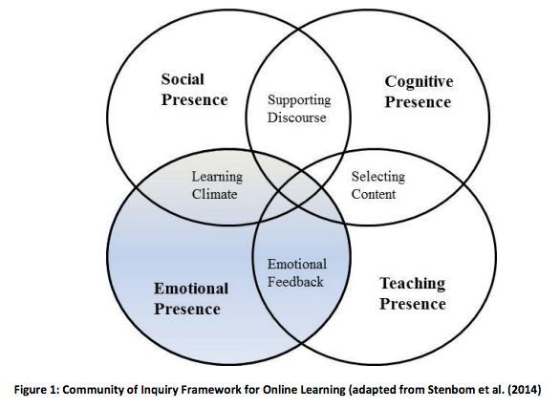
Community Model for Online Learning
Three ways students are ‘othered’ in online courses:
(a) professional
(b) academic
(c) ethnic
Each of which can lead to feelings of disconnection and isolation when learning online.
Lowenthal & Dennen (2017)
https://onlinelearninginsights.wordpress.com/tag/social-presence/

Slide 11
Social Presence: Complex Questions
Special Issue: Social Presence and Identity in Online Learning
Distance Education, Volume 38, Issue 2 (2017)
From the Editorial: by Lowenthal & Dennen.
How well [can] people learn in a setting limited to mediated interactions lacking various communication cues?
How can a teacher and students come to know each other if they cannot see each other?
How can they effectively understand and communicate with each other if they are separated by space and time?
These concerns are related to issues of social presence and identity, both of which are complex, multi-faceted, closely interrelated constructs

Slide 12
Identity in ‘Real-Life’ and Online
Identity: a fluid construct - negotiated both with our interaction partners and within the context.
“The contextual nature of identity means that people share versions of themselves in the different online settings they encounter.
Of concern to many online instructors and learners is not only the identity one shares while being present in a class, but also the identity that is refined and developed within the class – an identity that may be focused on entry into a profession.”
https://www.marzioscholten.com/identikit/

Slide 13
How might your lecturers promote Social Presence Online?
Sharing clear learning outcomes with students.
Communicating their expectations re: student participation in tasks and activities.
Not overwhelming students with too much content.
Encouraging students to put on cameras while speaking, engaging in dialogue in breakout rooms/chat boxes, on whiteboards and on discussion forums.
By ‘humanising interactions’ through more informal/casual language when welcoming students.
By asking students to introduce themselves.
By asking students to engage in ice-breaker activities.
By moderating discussion forums.

Slide 14
Activity
How do you normally engage with the lecturer and other students online?
What are some of the challenges of creating social presence when learning online?
How can you do more to promote your social presence when learning online?
Please comment in the chat or come on mic

Slide 15
Recap & Summary
Encouraged you to think proactively about how you meet and engage with fellow students and how you communicate with your lecturers in online learning environments.
To encourage you to actively participate in your learning.
Discussed some ideas on how your lecturers might help promote 'social presence' in the online environment.

Slide 16
Where from here?
This Photo by Unknown Author is licensed under CC BY-SA

Slide 17
Support & Resources
https://www.ul.ie/ctl/workshop-being-engaged-and-establishing-your-social-presence-online

Slide 18
Thank you
ul.ie

Slide 20
This work is licensed under a Creative Commons Attribution-NonCommercial 4.0 International (CC BY-NC 4.0)

